Slide 1
Scala
Scala, short for Scalable Language, is a hybrid functional programming language, Which means Scala is supports both functional programming as well as object oriented programming.
Functional programming is a programming paradigm in which we try to bind everything in pure mathematical functions style. It is a declarative type of programming style. Its main focus is on “what to solve” in contrast to an imperative style where the main focus is “how to solve”. It uses expressions instead of statements. An expression is evaluated to produce a value whereas a statement is executed to assign variables. Those functions have some special features discussed below.
Features of Scala
Scala smoothly integrates the features of object-oriented and functional languages which means scala is both object oriented and functional language.

Slide 2
Scala vs. Java: Key Differences
Complexity/leanness: Scala is designed to iron out complexities seen in Java, e.g. by replacing Java's several lines of code with one line.
Type form: Scala is statically typed. Java is dynamically typed.
Features: Scala has several options not available in Java, such as type inference, a powerful type system, pattern matching, traits, and proper higher order functions.

Slide 3
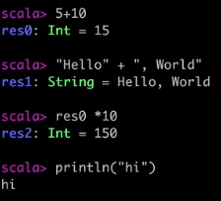
First Interaction with Scala
REPL
Open a terminal and type Scala <Enter>
Just type as example.
Observe It returned a result along with a variable res0
Notice that 5 + 10 returned result where as println does not return any result variable, because first one is an expression which yield a result but println is a statement that does some action.
Scala Variables (Immutable and mutable)
Scala has two types of variables
Val – It is similar to constant variable. (Immutable)
Var – Assignment can change (Mutable)
Scala encourages immutable data.
Note Paste mode
:paste <enter>
Paste mode in Scala REPL is where you type long programs and then execute them once

Slide 4
Expression and Statement
Expressions are unit of code that return a value, which also means anything that evaluates a value is an expression
Statements are unit of code that does not return any value.
Scala favors expressions over statements.
If/Else is expressions in scala
While – Not widely used in scala
For – For loop can be written in two ways as either expressions or statement
Imperative – Do some action using expression
Functional – Return a value
For loop is mostly not used instead developers prefer foreach or map function instead.

Slide 5
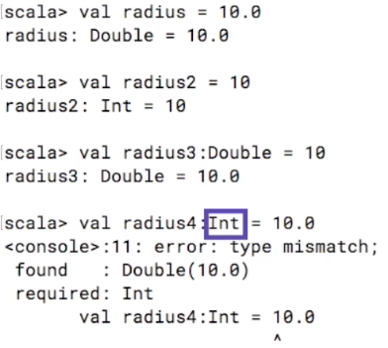
Type Inference
Type inference is something that scala tries to understand the type of the data automatically
Every type is scala is an object, that means an instance of class.
Any is the universal base class in scala
AnyVal descends from Any and is the base class for all java value types. E.g. int, boolean, double, char etc.
AnyRef also descends from Any and is the base class for all java reference types. E.g. Classes, String, Collections etc.

Slide 6
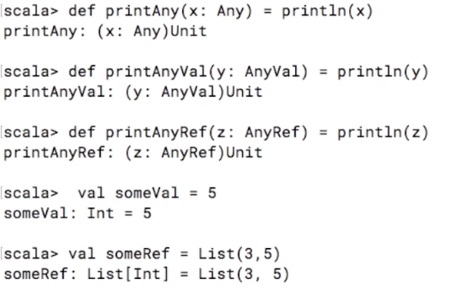
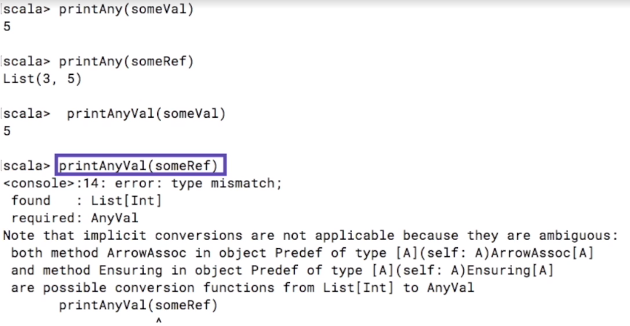
Any Type - Demo
**Return type Unit is similar to Java’s void.

Slide 7
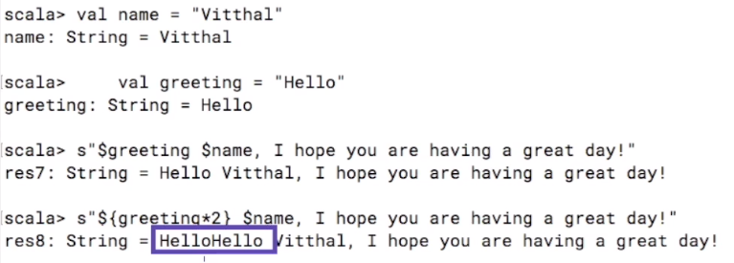
String Interpolation
S" is used for string interpolation here and without any space between s and "

Slide 8
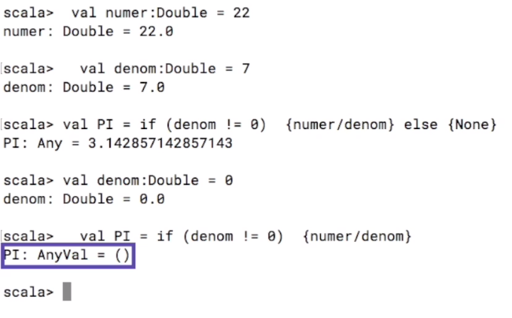
If/Else Expression
Notice below, if statement returned a value based on conditions and notice we don’t have to write any return keyword. The last expression or statement is automatically returned.

Slide 9
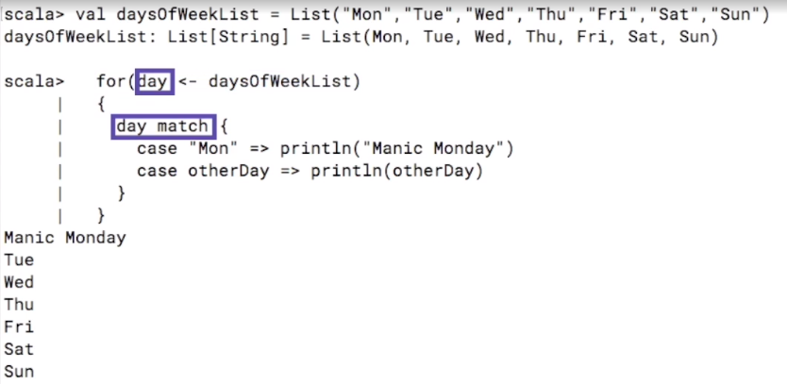
For Loops as Statement
Below example of for loop is just a statement and it prints some value by looping through the list.

Slide 10
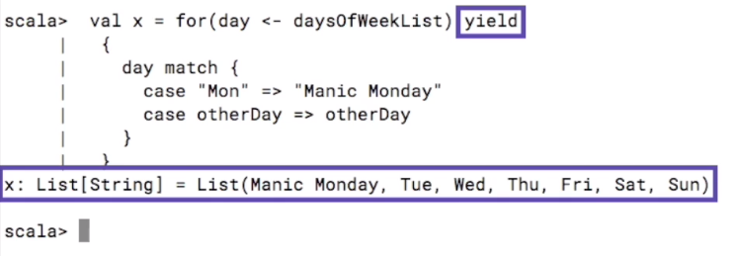
For Loop as expression
By adding the keyword yield, this for loop now add the result value to a list and returns a list instead, This is like an expression as it returns a value.

Slide 11
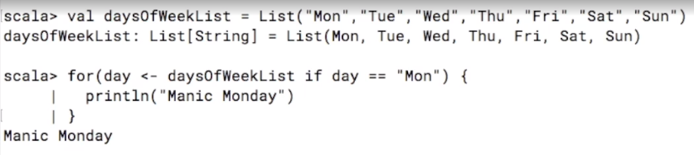
For loop with pattern guard
It’s basically a condition with for loop.
Like below example, the for loop is executed only if the day is Monday.

Slide 12
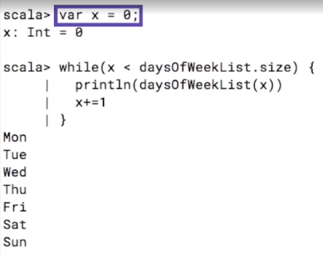
While loops
While loops are pure statements and can never return a value.
Loop variables has to be mutable, means it can be a var rather than a val.
So while loop is rarely used and syntax is really awkward.

Slide 13
Functions Vs. Methods
In Scala Functions are objects but methods are not. However methods can be stored and converted to objects seamlessly.
Below is an example of Method
def getarea(radious:Double) :Double =
{
val pi = 3.14;
pi*radious*radious
}
Note: Def keyword is used to create a method which may be stored in a class
Below is an example of Function
val getarea = (radious:Double) =>
{
val pi = 3.14;
pi*radious*radious
}:Double
Note: Its effectively and expression block assigned to a val getarea.

Slide 14
Methods
Create a Method
def getarea(radious:Double) :Double =
{
val pi = 3.14;
pi*radious*radious
}
Convert methods to Functions
val newfunc: (Double) => Double = getarea
Another way like below
val newfunc1 = getarea _
The _ is a shortcut and is not recommended way.
It take the type of whatever is on the right and assign it to left
Call the function
scala> newfunc(10)
res2: Double = 314.0

Slide 15
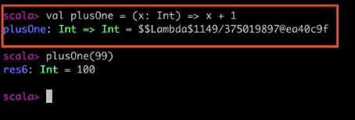
Functions
A functions is a named reusable expression block of codes.
def functionName (argument: Type): ReturnType = {body}
A function can be stored in a variable or value.
The return value of a function can be a function.
The parameter value (Input) of a function can be a function.
Anonymous Function
Implementing a function without given a name

Slide 16
Creating a new project in IntelliJ
Open up IntelliJ and select “Create New Project”
On the left panel, select Scala and on the right panel, select SBT, Click Next
Name the project “SBTExampleProject”
Make sure the JDK Version is 1.8 and the SBT Version is at least 0.13.13
Select Use auto-import so dependencies are automatically downloaded when available
Select Finish
Understanding the directory structure
- .idea (IntelliJ files)
- project (plugins and additional settings for sbt)
- src (source files)
- main (application code)
- scala (Scala source files) <-- This is all we need for now
- test (unit tests)
- target (generated files)
- build.sbt (build definition file for sbt)
https://docs.scala-lang.org/getting-started-intellij-track/building-a-scala-project-with-intellij-and-sbt.html

Slide 17
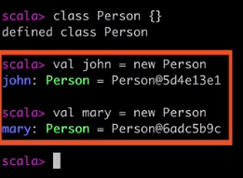
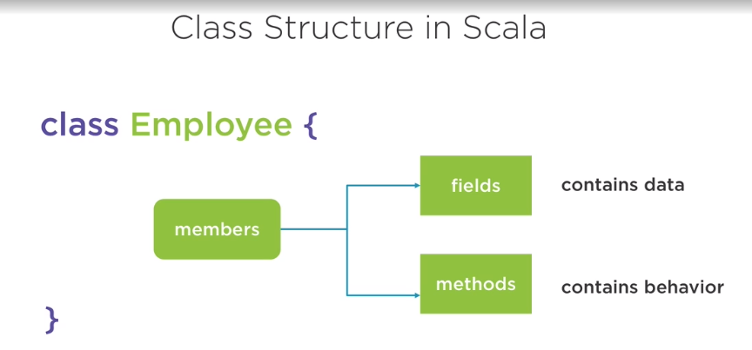
Class
A class is a blue print for the objects.
Class members
Fields – Nothing but variables declared in class
Methods – Nothing but the behavior of the fields.

Slide 18
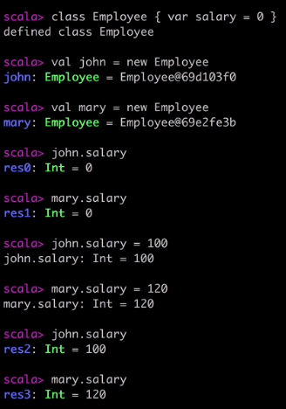
Class

Slide 19
Class parameters
class Employee(val first: String, val last: String) { override def toString: String = first + " " + last } val obj1 = new Employee("Sandeep","Mohanty") //First and last are the parameters here not the class members like field or methods //Note: We don't have to call toString method as compiler by default calls it // when we create the instance of the class //

Slide 20
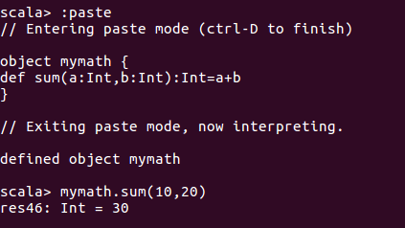
Understanding Singleton objects
Singleton object is an object that does not need a new keyword to create an object.
There is just one instance or object created with the class name and stays in memory (JVM) and is initialized when someone first time access it.
There are two ways to create singleton instance
Declare as object type
Create companion obects

Slide 21
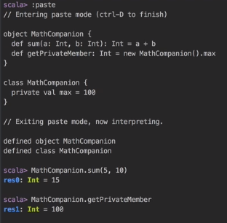
Companion object(Apply)
Notice they both live in same source file as class , notice in REPL used :paste
The companion object and class must have same name
They both can access each others private members.
New keyword is used to create object of any class.
However, In Scala, There is another way to create object of a class without using new keyword, i.e. apply method. Apply method is available as companion object.

Slide 22
Class Vs. Companion Object
class Employee (f:String,l:String,s:Int) { private val deptCode: Map [String, String] = Map( "HR"->"Human Resource", "Fin" -> "Finance" ) private val first : String = f private val last : String = l private var stock : Int = s //Notice stock is var as It can be latered later. def getfirst : String = first def getlast : String = last def getStock :Int = s def awardStock(moreStocks : Int) : Unit = stock += moreStocks //Unit is similar to Java VOID def getDept(code : String) : String = deptCode.getOrElse(code, "Department does not exist") override def toString: String = first + " " + last } val emp = new Employee("Sandeep", "Kumar", 20) //Ideally why should I create an instance even before I know the employee name emp.getDept("HR") //Lets make this code better by using singleton object // we can use keyword object instead of class, see the object.sc worksheet

Slide 23
Class Vs. Companion Object
class Employee (f:String,l:String,s:Int) { private val first : String = f private val last : String = l private var stock : Int = s //Notice stock is var as It can be latered later. def getfirst : String = first def getlast : String = last def getStock :Int = s def awardStock(moreStocks : Int) : Unit = stock += moreStocks //Unit is similar to Java VOID override def toString: String = first + " " + last } object Employee { private val deptCode: Map [String, String] = Map( "HR"->"Human Resource", "Fin" -> "Finance" ) def getDept(code : String) : String = deptCode.getOrElse(code, "Department does not exist") def apply(f: String, l: String, s: Int): Employee = new Employee(f, l, s) //Introduced the apply method so the new keyword is not needed. } val emp = Employee("Sandeep", "Kumar", 20) emp.getlast Employee.getDept("HR")

Slide 24
Understanding functional objects
class Employee (f:String,l:String,s:Int) { private val first : String = f private val last : String = l private var stock : Int = s //Notice stock are now val unlike previous example var and we made it immutable. def getfirst : String = first def getlast : String = last def getStock :Int = s def awardStock(moreStocks : Int) : Employee = Employee(first, last, stock + moreStocks) //Notice here the method type is Employee now and we initialize the instance here by accessing it // Also every time the more stocks are awarded it will create a new instance as stock variable is val type //This is called functional objects, where you have objects containing the state but have functions return the new object override def toString: String = first + " " + last + " " + stock } object Employee { def apply(f: String, l: String, s: Int): Employee = new Employee(f, l, s) } val emp = Employee("Sandeep", "Kumar", 20) emp.awardStock(10)

Slide 25
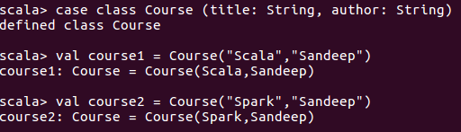
Case Class
The case classes are the classes that starts with case modifier.
The scala automatically creates a companion object for the class and calls apply method to it, so that we don’t need to create a object with new keyword.
All the arguments in case class are immutable.

Slide 26
Traits
A trait is like an interface with a partial implementation. In scala, trait is a collection of abstract and non-abstract methods.
You can create trait that can have all abstract methods or some abstract and some non-abstract methods.
Traits are used to share Methods and fields between classes.
Scala does not have interfaces but traits are similar to Java 8’s interfaces.
Classes and objects can extend traits.
Traits cannot be instantiated and therefore have no parameters.
import java.util.UUID trait Db { private var contents: Map[String, String] = Map.empty protected def save(key: String, value: String): Unit = contents += (key -> value) def get(key: String): Option[String] = contents.get(key) } class Bank extends Db { def openAccount(userID:String): String = { val accountID = "A-" + UUID.randomUUID() save(userID,accountID) accountID } def getAccount(userID:String) : Option[String] = get(userID) } val bank = new Bank val uid_1 = "U-" + UUID.randomUUID() val uid_2 = "U-" + UUID.randomUUID() val acc_num_1 = bank.openAccount(uid_1) val acc_num_2 = bank.openAccount(uid_2)

Slide 27
Abstract Class
What is the advantage of using abstract classes instead of traits?
Abstract classes can have constructor parameters as well as type parameters. Traits can have only type parameters.
Abstract classes are fully interoperable with Java. You can call them from Java code without any wrappers. Traits are fully interoperable only if they do not contain any implementation code
Whenever you implement a reusable collection of behavior, you will have to decide whether you want to use a trait or an abstract class. There is no firm rule, but this consider below.
If the behavior will not be reused, then make it a concrete class.
If it might be reused in multiple, unrelated classes, make it a trait. Only traits can be mixed into different parts of the class hierarchy.
If you plan to distribute it in compiled form, and you expect outside groups to write classes inheriting from it, you might lean towards using an abstract class. The issue is that when a trait gains or loses a member, any classes that inherit from it must be recompiled, even if they have not changed.
If efficiency is very important, lean towards using a class.
If you still do not know, after considering the above, then start by making it as a trait. You can always change it later, and in general using a trait keeps more options open.

Slide 28
Scala collections
Scala has a rich set of collection library. Collections are containers of things. Those containers can be items like List, Set and Map.
Immutable and Mutable Collections
Scala collections are classified under mutable or immutable collections
scala.collection.immutable
This guarantees that once a collection is created, it will not change.
They still supports add, remove and update functions but they generate new collections instead of changing the existing collections.
This is default feature of collections and Scala encourages to use them.
scala.collection.mutable
This will update and extend the collections in place.
This can be used by developer if required by explicitly calling scala.collection.mutable in code base.

Slide 29
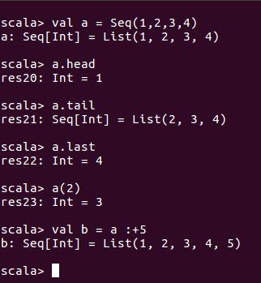
Sequences
Sequences are a type of collection or data structures where order of the element matters.
Seq is a trait, which is equivalent to Java's interface.
Example, Observe, It uses a list.

Slide 30
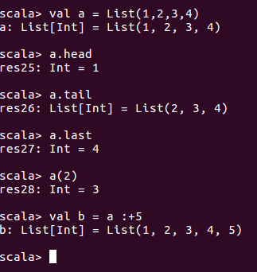

List in Scala
A list in scala is represented in scala as linked list and be more used like sequence.

Slide 31
List operations
scala> val a = List(1,2,3,4,5,6,7)
scala> val b = List("Mon","Tue","Wed","Thu","Fri","Sat","Sun")
scala> a.zip(b)
scala> a.head
scala> a.tail
scala> a.size
scala> b.reverse
scala> b(2)
scala> b.contains("Mon")
scala> for(item <- b) println(item)

Slide 32
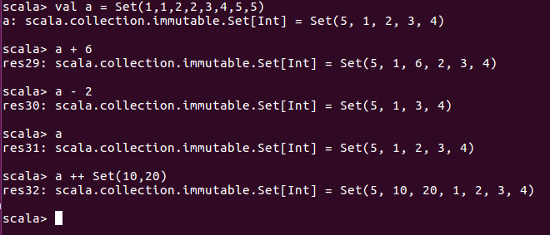
Sets
Sets are the type of the collection where the elements of the collection has to be unique.

Slide 33
Map
Map is a special kind of collection where elements are stored as key and value, where keys are unique.
It is further classified into
SortedMap – Where keys are unique and sorted.
scala> val weekends = Map(1->"Sunday",2 ->"Saturday")
weekends: scala.collection.immutable.Map[Int,String] = Map(1 -> Sunday, 2 -> Saturday)
scala> weekends.foreach((item:(Int,String)) => println(item._1 + " " + item._2))
1 Sunday
2 Saturday
scala> weekends(2)
res1: String = Saturday
scala> weekends + (3 -> "Friday")
res2: scala.collection.immutable.Map[Int,String] = Map(1 -> Sunday, 2 -> Saturday, 3 -> Friday)

Slide 34
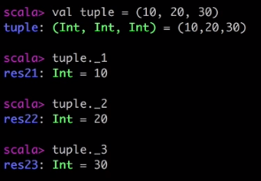
Tuples
Tuples in Scala are accessed by their positions like below.

Slide 35
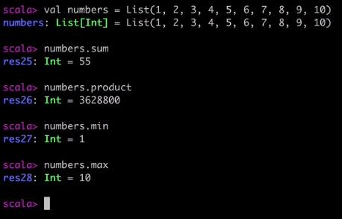
Methods on numeric collection

Slide 36
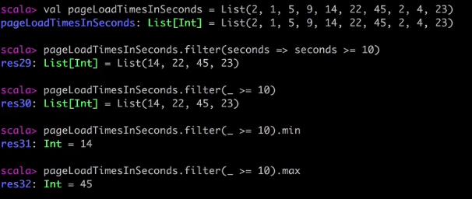
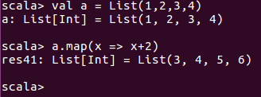
Operations on collection

Slide 37
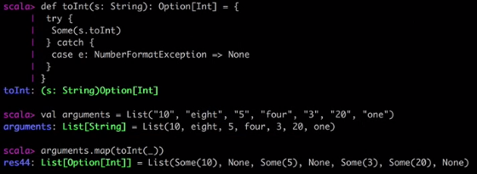
Option
A powerful Scala idiom is to use the Option class when returning a value from a function that can be null. Simply stated, instead of returning one object when a function succeeds and null when it fails, your function should instead return an instance of an Option, where the instance is either:
An instance of the Scala Some class
An instance of the Scala None class
Because Some and None are both children of Option, your function signature just declares that you're returning an Option that contains some type (such as the Int type shown below). At the very least, this has the tremendous benefit of letting the user of your function know what’s going on.

Slide 38
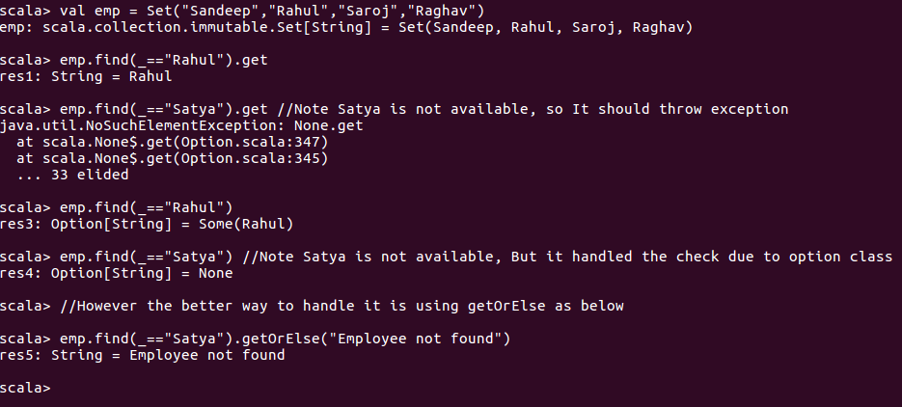
Handling Option
It is a great alternative to do null check beforehand when you suspect you may get null for any input but not sure.

Slide 39
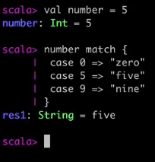
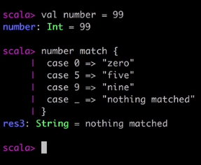
Pattern Matching
Pattern match is a mechanism for checking a value against a pattern.
It is a more powerful version of switch statement in java.
Match on Constants

Slide 40
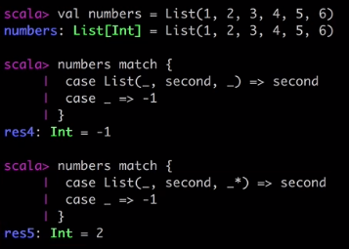
Pattern Matching on Sequence
Notice the wildcard pattern in second example, which returns the sequence of any length.

Slide 41
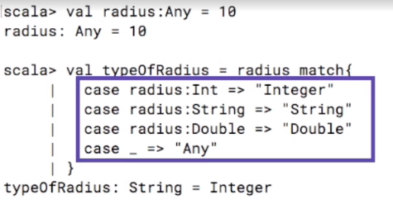
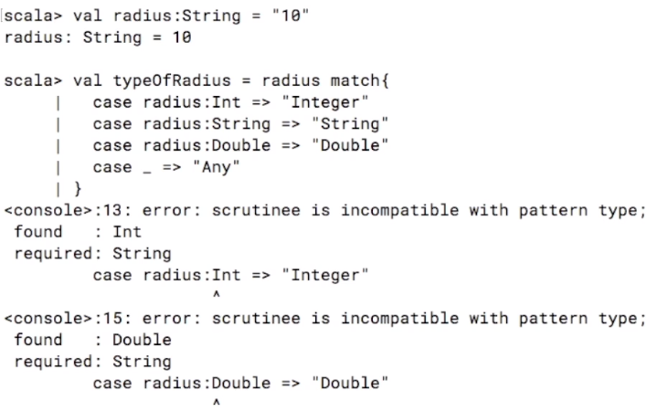
Pattern matching on Types

Slide 42
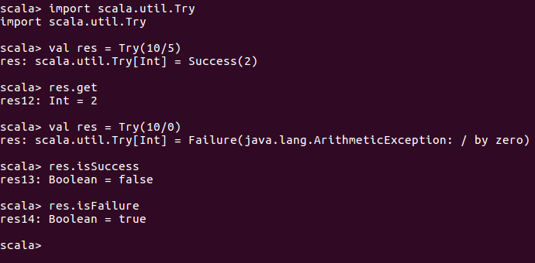
Error Handling with TRY
In Scala, Try works a bit differently than java
It returns the result either as a value if success or returns exception if failure.

Slide 43
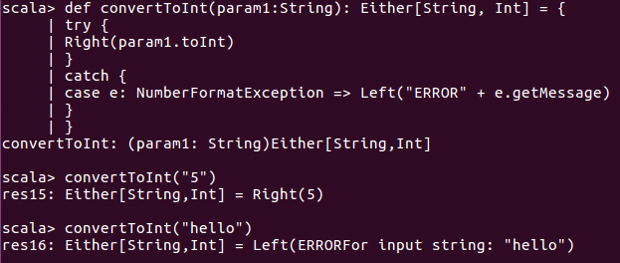
Error Handling with Either
Either is similar like option but instead of returning none or some it returns left or right.
Right returns the success value as expected and in case of unknown it returns mentioned left action.

